Slide 1
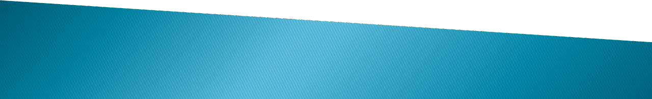
“REAL TIME AND CONTEXT AWARE SIGN LANGUAGE RECOGNITION SYSTEM”
…. College of Engineering
Seminar
On
Guided By
Prof.
Presented By.
-Students Name
-
-
-

Slide 2

CONTENTS
Introduction
Aim & Objective
Problem Definition
Proposed System
Algorithm
System Architecture
Advantages
Disadvantages
Conclusion
Reference

Slide 3
INTRODUCTION
Sign language is a vital means of communication for the hearing-impaired community, relying on hand gestures, facial expressions, and body language to convey messages. However, communication barriers often arise between individuals who use sign language and those who do not understand it, limiting the integration of hearing-impaired individuals into society. As a solution, sign language recognition systems can play a crucial role in translating these gestures into written or spoken language, thus facilitating communication and improving accessibility. This project, titled "Sign Language Recognition," focuses on developing a machine learning model capable of recognizing and translating American Sign Language (ASL) gestures into their corresponding English alphabets.

Slide 4
AIM
“ To design Real Time And Context Aware Sign Language Recognition System”.
OBJECTIVES
To develop a machine learning model capable of recognizing sign language alphabets. To implement a real-time hand gesture detection system using a front-facing camera. To enhance recognition accuracy by integrating deep learning techniques such as CNN (Convolutional Neural Networks) and LSTM (Long Short-Term Memory) models. To create a context-aware system that predicts and suggests words based on recognized signs. To develop a user-friendly interface that displays recognized words in real time. To ensure efficient performance, low latency, and scalability of the system.

Slide 5
PROBLEM DEFINATION
The problem addressed by a real-time and context-aware sign language recognition system is the communication barrier faced by deaf individuals with hearing individuals. This barrier arises due to the inability of hearing individuals to understand and respond to sign language, and the difficulty faced by deaf individuals in communicating with those who do not understand sign language. To overcome this, the system must accurately recognize sign language gestures in real-time, interpret the meaning of signs based on context, accommodate various sign languages, and be accessible to individuals with disabilities.

Slide 6
PROPOSED SYSTEM
The proposed system aims to address the communication barrier faced by deaf individuals by providing a real-time and context-aware sign language recognition solution. The system will utilize advanced computer vision techniques to accurately recognize sign language gestures from video input. By incorporating deep learning models, the system will be able to learn and adapt to different sign language variations, including regional dialects and individual styles. Additionally, the system will incorporate contextual understanding capabilities, considering facial expressions, body language, and previous signs to improve recognition accuracy and comprehension. A user-friendly interface will enable seamless interaction between deaf and hearing individuals, facilitating effective communication. The system will be designed to be compatible with various devices, including smartphones, tablets, and computers, ensuring accessibility and widespread adoption.

Slide 7
ALGORITHM Step 1:
Camera Recording Using OpenCV
When the user opens the camera, the system will initialize the camera using the OpenCV library. OpenCV (Open Source Computer Vision Library) is a powerful tool used for real-time computer vision applications. The camera feed is accessed through cv2.VideoCapture() in OpenCV. The system continuously captures frames (images) from the camera feed in real-time. Each frame represents a still image of what the camera sees at that moment, which can then be processed.

Slide 8
Step 2:
Splitting the Recording into Frames
After obtaining the camera feed, the video is automatically split into multiple frames. A frame is a single image that represents a moment in time within the video stream. Each second of the video consists of multiple frames (typically 24 to 30 frames per second, depending on the camera's frame rate). The system captures these frames continuously and processes them individually for gesture detection.

Slide 9
Step 3:
Feature Extraction in Image Processing
Once each frame is captured, the feature extraction process begins. Feature extraction is the key step in image processing where relevant characteristics (features) of the hand gesture, such as edges, shapes, and patterns, are identified. The image is first preprocessed (grayscale conversion, resizing) to standardize its dimensions and reduce complexity. Techniques such as edge detection (e.g., using Sobel, Canny edge detectors) and thresholding may be applied to enhance key features. The system extracts essential patterns from the hand gesture image, focusing on the shape and orientation of the fingers.

Slide 10
Step 4:
Feature Extraction in Image Processing
Once each frame is captured, the feature extraction process begins. Feature extraction is the key step in image processing where relevant characteristics (features) of the hand gesture, such as edges, shapes, and patterns, are identified. The image is first preprocessed (grayscale conversion, resizing) to standardize its dimensions and reduce complexity. Techniques such as edge detection (e.g., using Sobel, Canny edge detectors) and thresholding may be applied to enhance key features. The system extracts essential patterns from the hand gesture image, focusing on the shape and orientation of the fingers.

Slide 11
Step 5:
Gesture Recognition and Alphabet Display
After the CNN processes the image and identifies the gesture, it outputs the predicted alphabet corresponding to the recognized hand sign. The system then prints or displays the alphabet on the screen for the user to see. The model generates a prediction, which is an array of probabilities for each alphabet (A-Z). The system identifies the highest probability and assigns the corresponding alphabet to the recognized hand gesture. The alphabet is displayed on the screen in real-time, allowing the user to know which sign was detected.

Slide 12
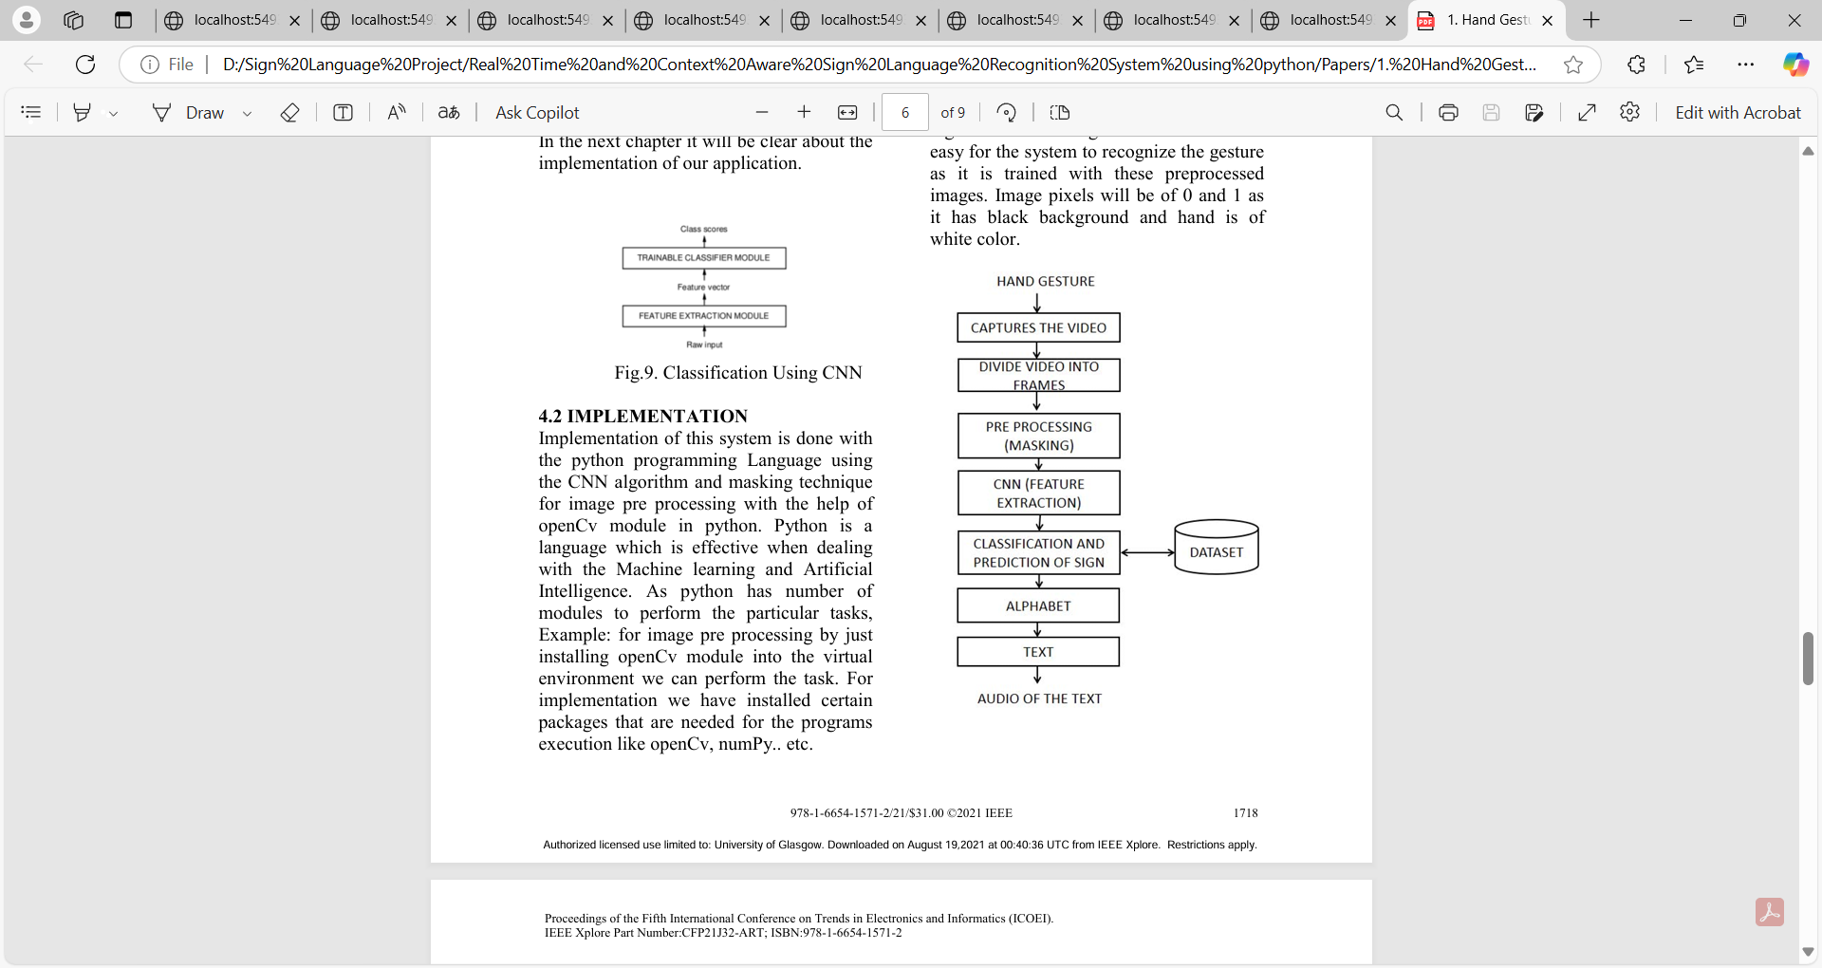
ALGORITHM DIAGRAM:

Slide 13
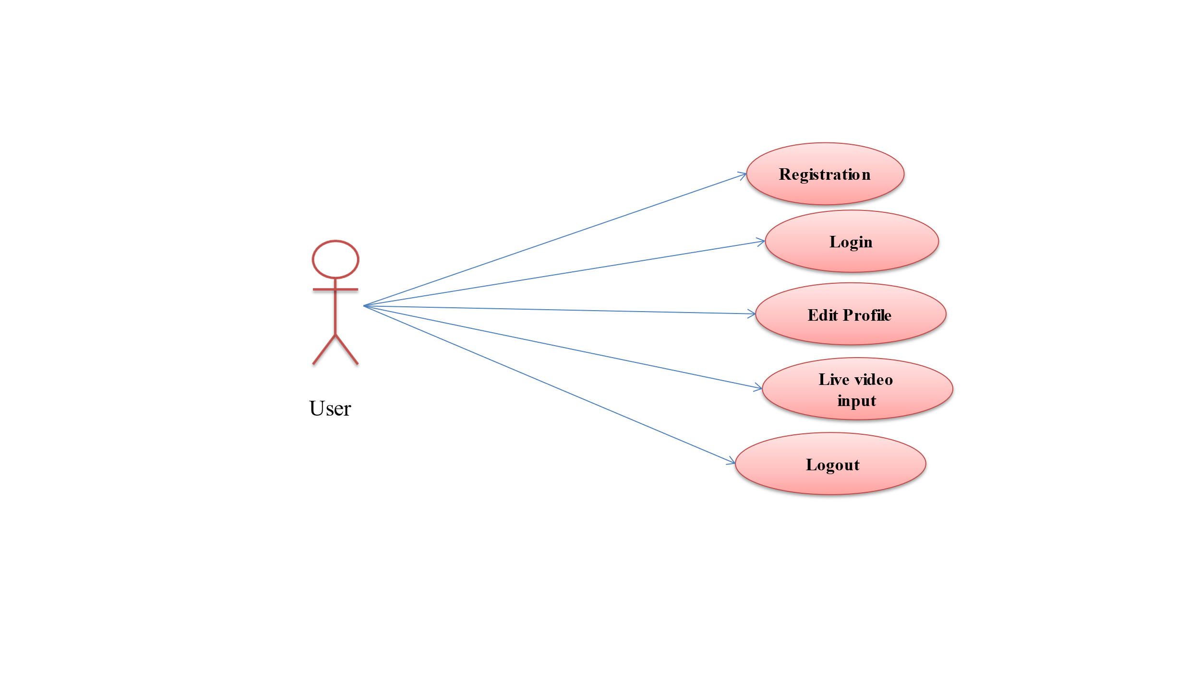
USER MODULE

Slide 14
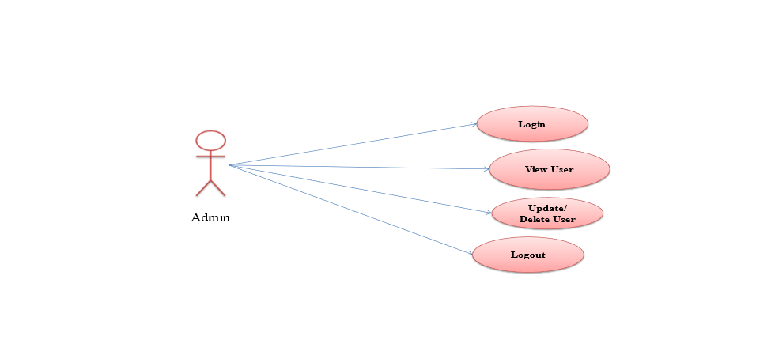
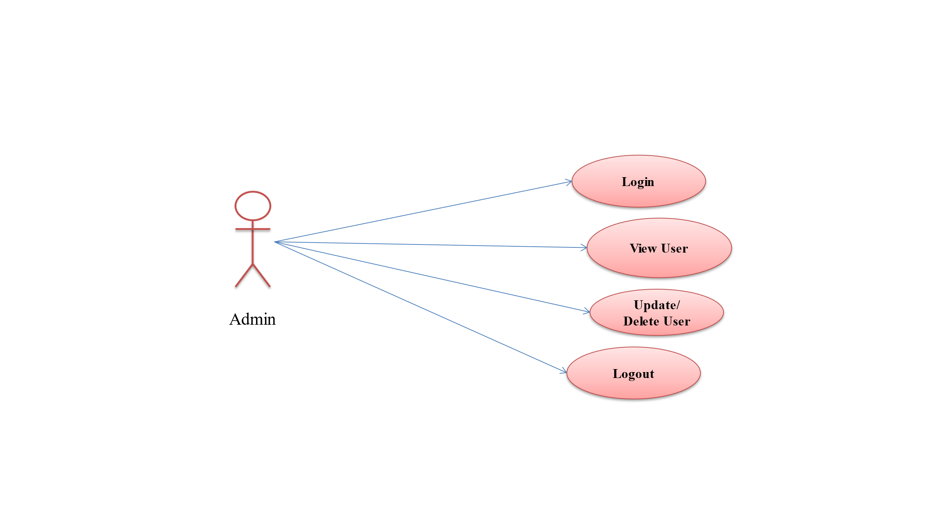
ADMIN MODULE

Slide 15
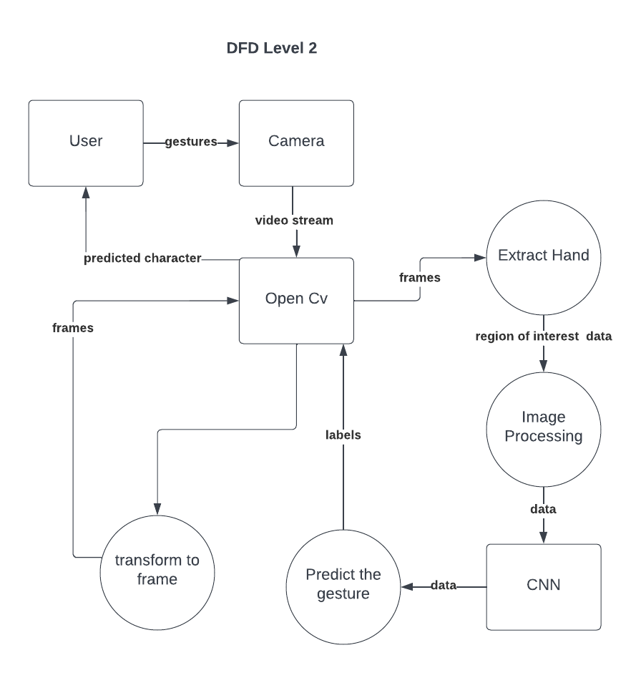
Data Flow Diagram
SYSTEM DESIGN
Login / Register
Send Request to
Patients
Create medical records
for accepted patients
View Patients
Profiles
Logout

Slide 16
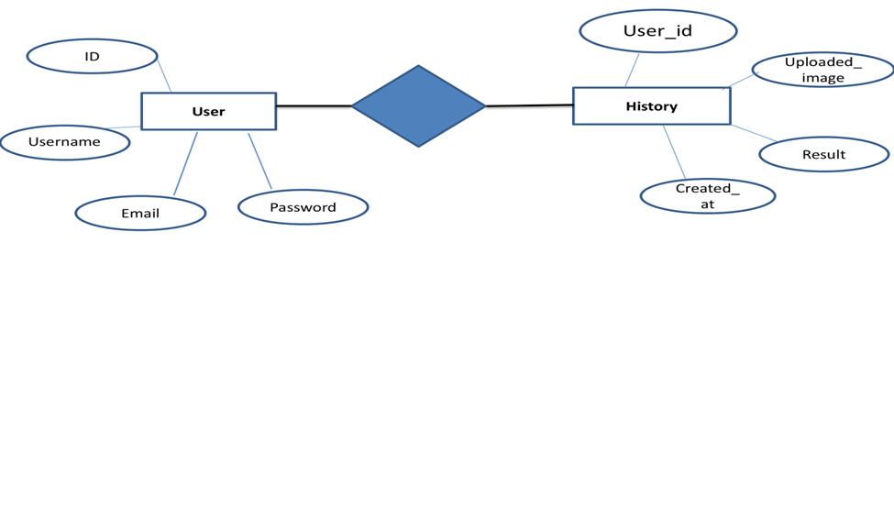
ENTITY RELATIONSHIP DIAGRAM

Slide 17
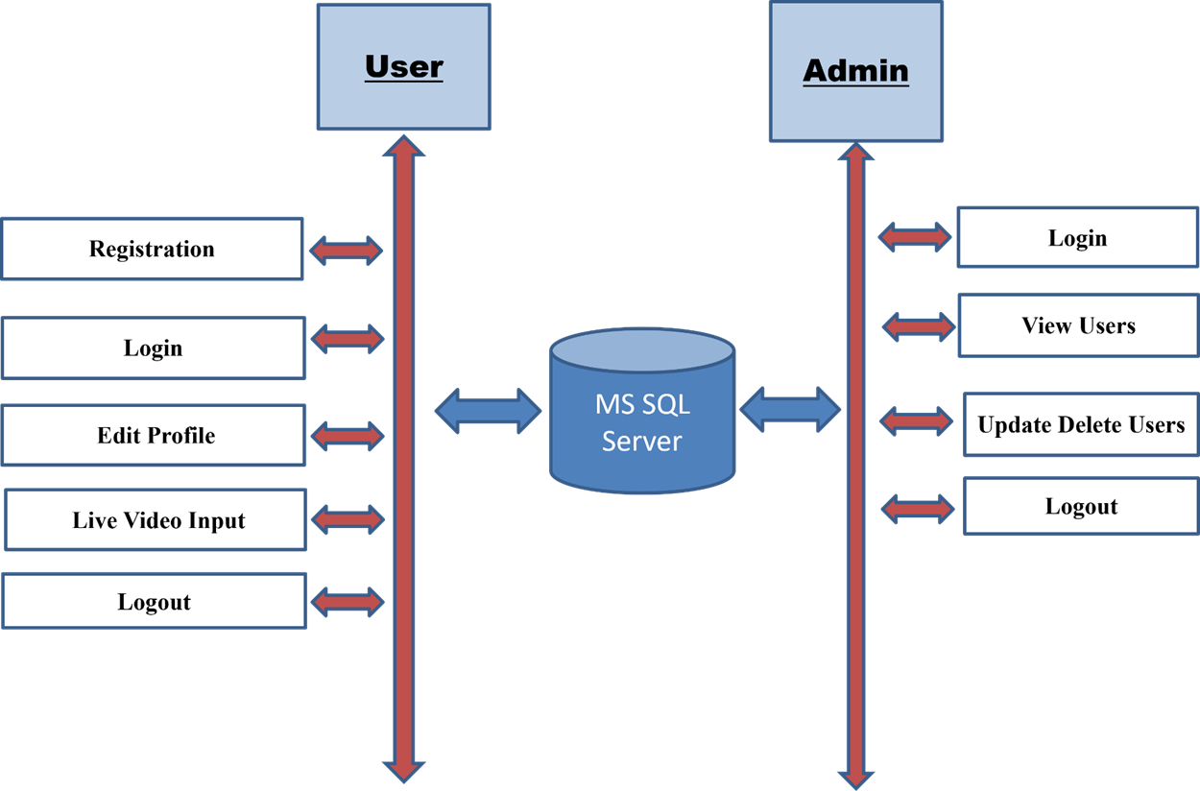
SYSTEM ARCHITECTURE
Login / Register
Provie Records Authenticity and give proof of work
Logout

Slide 18
SOFTWARE REQUIREMENT
Software Requirements
Operating System : windows 7, windows 8 and Upper version
IDE Tools : PyCharm
Front End : HTML / CSS / Bootstrap
Framework : Flask
Database/Back End : MySQL
Coding Language : Python

Slide 19
HARDWARE REQUIREMENT
High-resolution front-facing camera, GPU-enabled system for deep learning model execution, and sufficient RAM for processing.
Processor: Intel i5/i7 or AMD equivalent
RAM: Minimum 8GB (Recommended: 16GB)
Storage: Minimum 100GB free space
Graphics Card: Not required but beneficial for visualization
Operating System: Windows 10/11, Linux (Ubuntu), or macOS software.

Slide 20
ADVANTAGES
Improved communication: Bridges the communication gap between deaf and hearing individuals, promoting inclusivity and social interaction.
Enhanced accessibility: Enables deaf individuals to participate more fully in society and access information and services.
Increased independence: Provides deaf individuals with greater autonomy and independence in their daily lives.
Educational benefits: Facilitates learning and education for deaf students by providing a more accessible and interactive learning environment.
Economic benefits: Can contribute to economic growth by enabling deaf individuals to participate more fully in the workforce.

Slide 21
DISADVANTAGES
Technical limitations: Current technology may still have limitations in terms of accuracy, speed, and robustness, especially in challenging environments.
Language variations: Handling regional dialects, accents, and individual variations within sign languages can be challenging.
Privacy concerns: The use of cameras and other sensors for sign language recognition raises privacy concerns.
Cost: Developing and implementing such a system can be expensive, especially for smaller communities.
Cultural sensitivity: Ensuring that the system is culturally sensitive and respectful of different sign language communities is important.

Slide 22
CONCLUSION
This IoT Based Smart Waste Management System (Automatic Dustbin) will be a significant step towards automating waste management, ensuring timely waste collection, and contributing to a cleaner and more sustainable environment. By leveraging IoT technologies, the project will optimize waste disposal processes and reduce environmental pollution

Slide 23
REFERENCE
Koller, O., et al. "Deep Learning for Sign Language Recognition." Proceedings of the IEEE International Conference on Computer Vision, 2016.
Pigou, L., et al. "Sign Language Recognition Using Convolutional Neural Networks." European Conference on Computer Vision Workshops (ECCVW), 2014.
Kumar, A., et al. "Sign Language Recognition: A Deep Learning Approach Using Convolutional Neural Networks." International Journal of Computer Applications, 2019.
Molchanov, P., et al. "Hand Gesture Recognition with 3D Convolutional Neural Networks." IEEE Conference on Computer Vision and Pattern Recognition (CVPR), 2015.
Papastratis, I., et al. "A Review of Hand Gesture Recognition in Sign Language Recognition Systems." Multimedia Tools and Applications, 2021.

Slide 24


